Slide 1
University of Porto Innovation
ERA NET - New INDIGO
9 September 2011 | IBMC

Slide 2
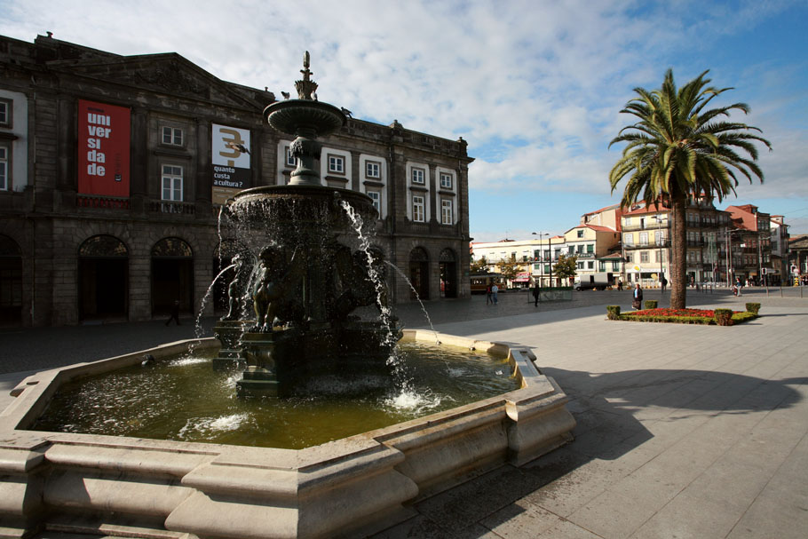
UPIN
Funded in 2004, as the University of Porto Knowledge Transfer Office.
Promote sustainable forms of knowledge and technology transfer and strengthen U.Porto links to industry
© 2008 Maria M. Oliveira

Slide 3
UPIN
Department of the rectorate of U.Porto
8 full time people
Funded by mixture of university baseline funding and grant income from projects
Act at the University level

Slide 4
UPIN
R&D funding programmes
R&D results valorisation and entrepreneurship
Industry-University liaison
  Search and dissemination of R&D international funding opportunities
  Support in proposal drafting
  - Project management
Management of Intellectual property rights
Technology transfer
Entrepreneurship programmes
Support spin-off creation
- Scanning of R&D results & skills
Identify industry R&D & innovation needs;
- Serve as liaison with Industry

Slide 5
Some steps for an FP7 proposal preparation

Slide 6
From the idea to the project
Idea
Call
Proposal
Evaluation
Negotiation
Grant Agreement
Beginning of the project

Slide 7

Idea of the project
Idea of the project
Elaboration of a project sheet, in English:
What do you want to do?
What’s your project’s main objective?
Which concrete problems does it solve? Which impact will it have?
How is it different from other already funded projects?
Which means and resources are needed? Which steps are needed?

Slide 8

FP7 projects’ characteristics
Characteristics of a European project
Transnational cooperation
Multinational and interdisciplinary consortia
Projects and activities of interest for the European Community => European dimension
High competition
High budget available

Slide 9
Idea of the project
Matching your idea with the funding programme’s characteristics
GOOD MATCH!!
3. Look for an FP7 call

Slide 10
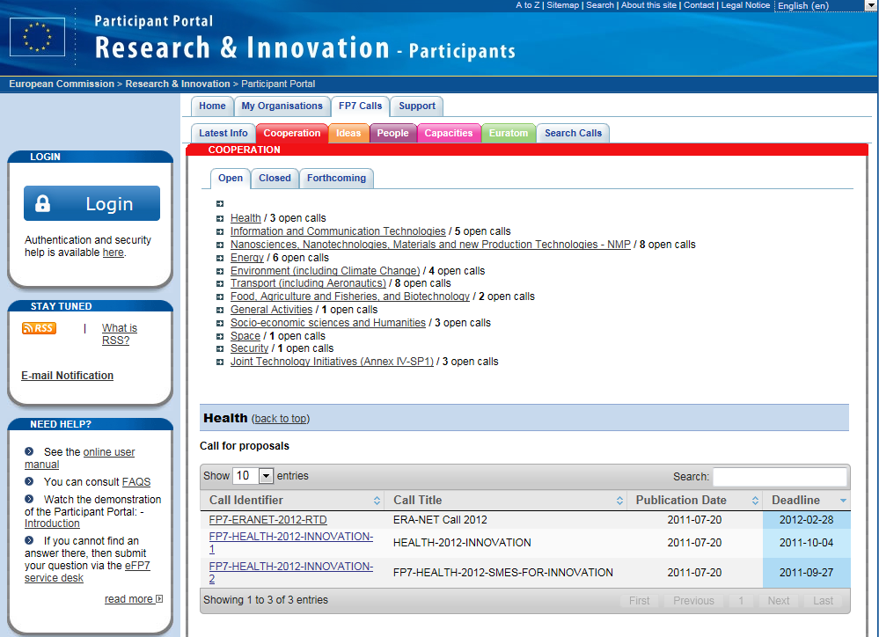
Identification of the Call
Identify the call (Call for Proposals)
Participant Portal – Look and download of the key documents
  Call Fiche
  Work Programme
  Guide for Applicants
  Additional information: Financial & Evaluation Guides, etc

Slide 11
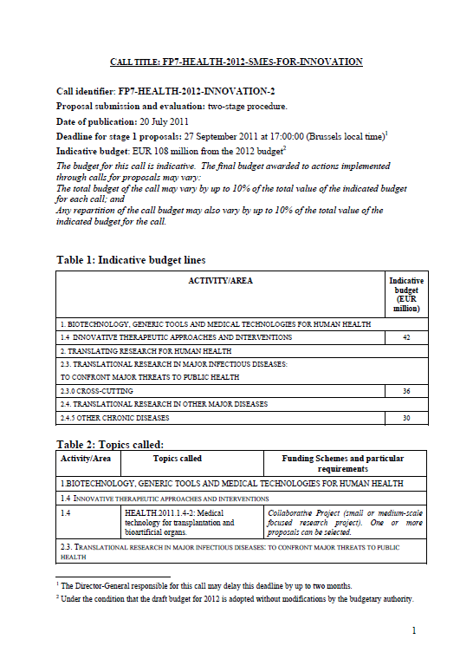
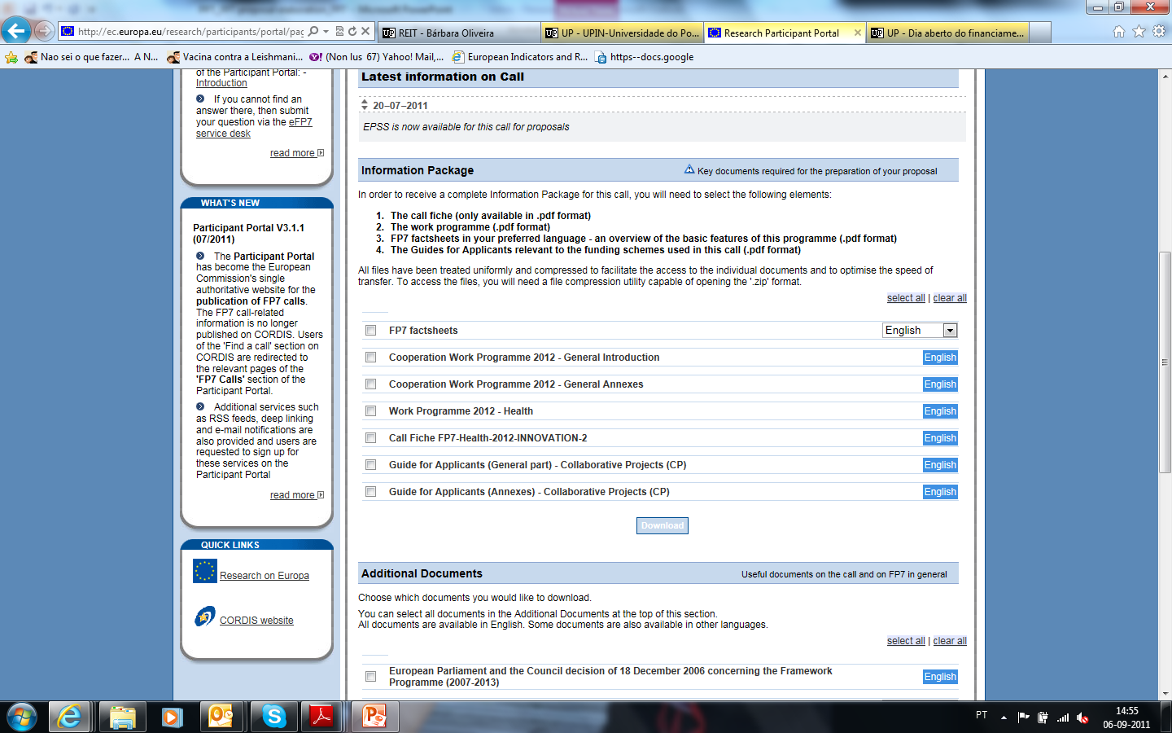
Key documents: Call Fiche

Slide 12


Key documents: Work programme

Slide 13
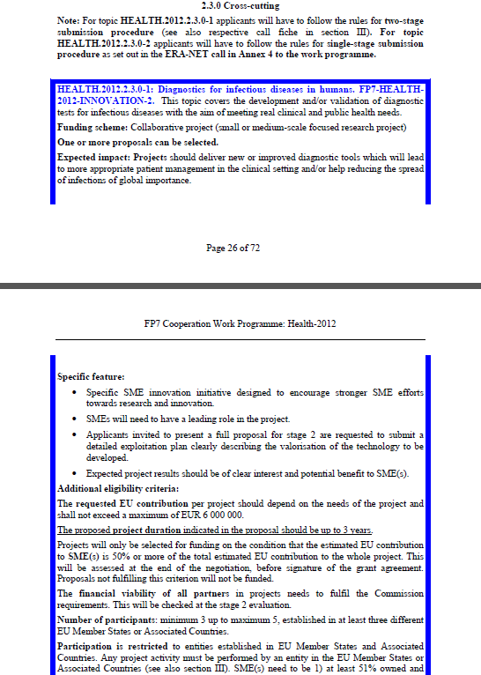
Key documents: WP and topic

Slide 14
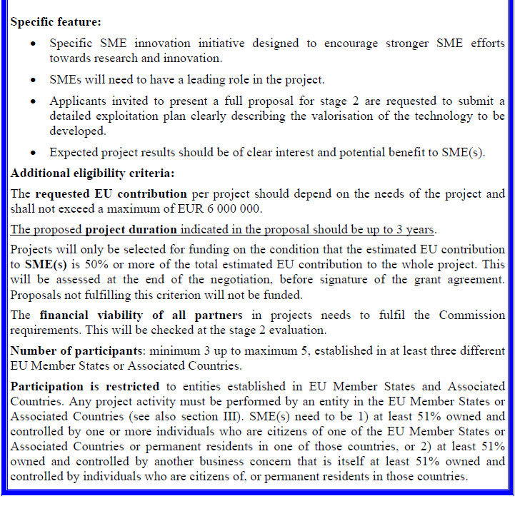
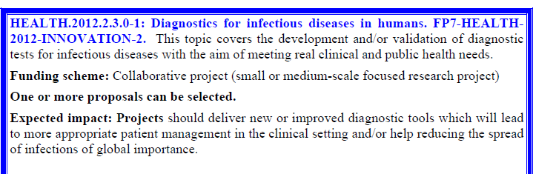
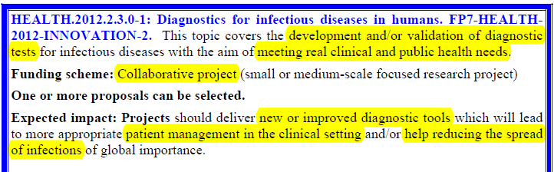
Analysis of the topic in the WP

Slide 15
Funding scheme
Funding scheme | Description
Collaborative Projects (CP) | New knowledge, technologies, products, demonstration activities or common ressources for research | Small or medium-scale focused research Project (STREP) | Well defined aim; Work plan strict | SICA – Specific International Cooperation Action SME-targeted collaborative projects
 |  | Large-scale Integrating Project (IP) | Project with a large aim; Autonomous management
Network of Excellence (NoE) | Common programme implementation of activities between organizations in a strategic domain. Long duration collaboration

Slide 16
Funding scheme
Funding scheme | Description
Research for the benefit of SMEs | Support to SMEs to subcontract R&D services
Coordination and Support Action (CSA) | Support to R&D activities and politics: Networking, exchange experience, transnational access transnacional research infrastructures, studies, conference organizations, etc. | Coordination Action (CA) | Support to activities of management and networking of research At least 1 consortium
 |  | Specific Support Action (SA) | Implementation of frameworks and definition and development of politics for the scientific communities At least 1 partner

Slide 17


Key documents: Guide for Applicants

Slide 18
Analysis of the Guide for Applicants
Main document:
Information on the funding scheme
Eligibility criteria for participation and submission
Check-list
Annexes:
Evaluation criteria
Details on contents of form A and form B

Slide 19
Project elaboration: process
Submission
Identify the call & EPSS registration
Elegibility and requirement
Final validation
Developing the idea
Idea
Proposal
Part A
Partners
Budget definition
Proposal
Part B
Work plan definition

Slide 20
EPSS registration
Submission
Identify the call & EPSS registration
Elegibility and requirement
Final validation
Developping the idea
Idea
Proposal
Part A
Partners
Budget definition
Proposal
Part B
Work plan definition

Slide 21
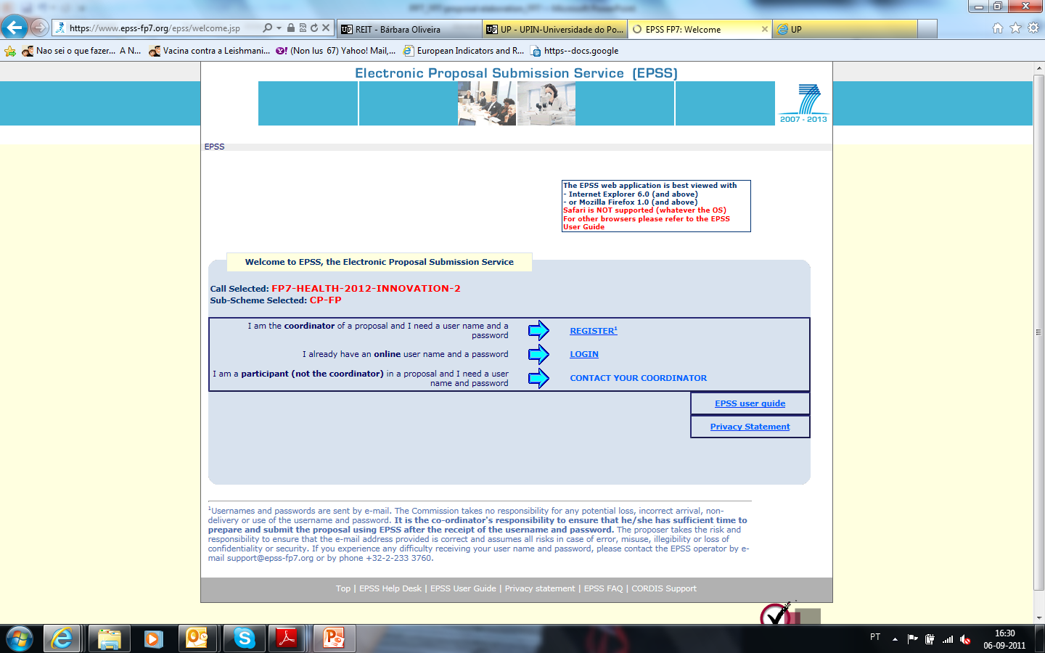
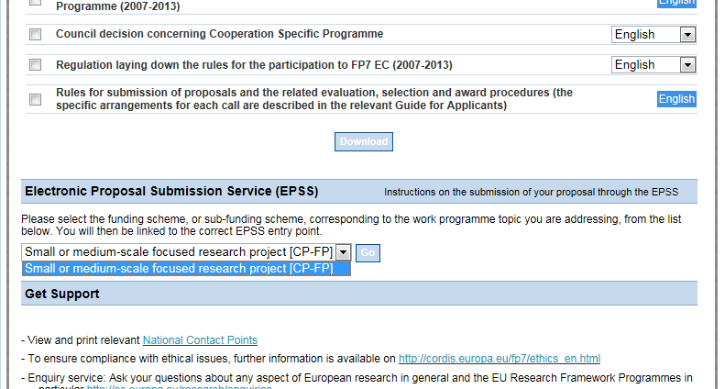
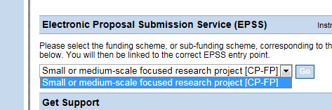
EPSS registration

Slide 22
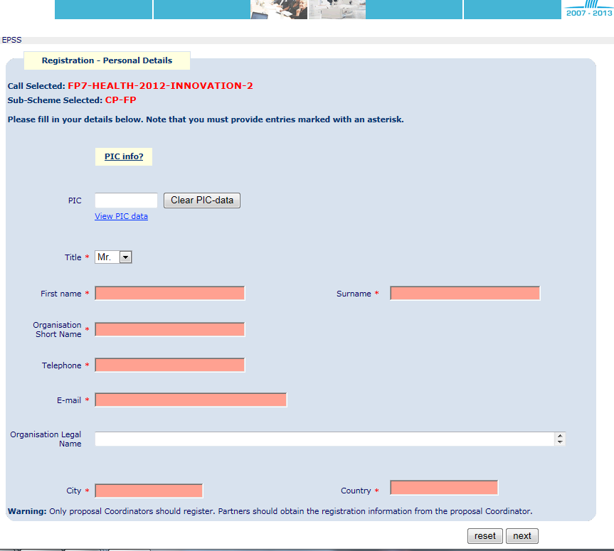
EPSS registration
For the coordinator only:

Slide 23
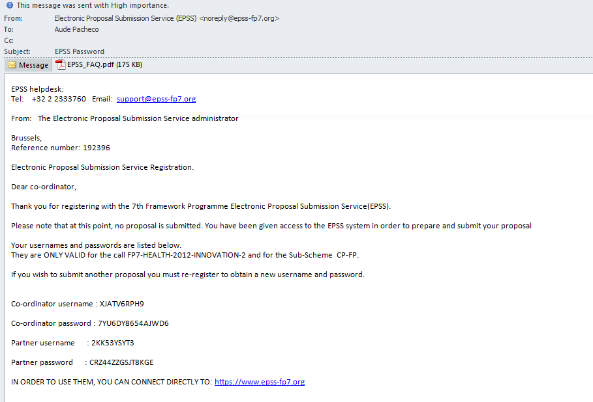
EPSS - Passwords

Slide 24
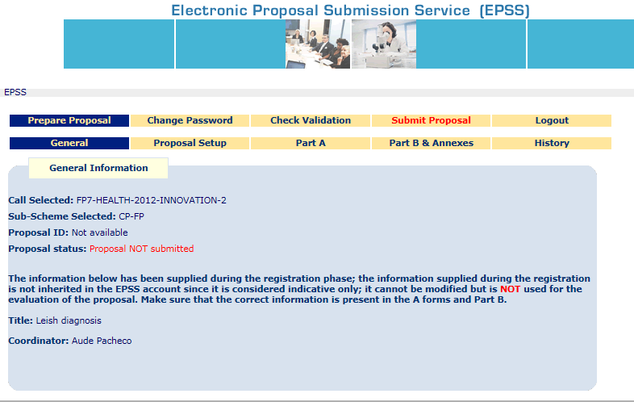
EPSS use
For all the partners:

Slide 25
Eligibility criteria and requirements
Submission
Identify the call & EPSS registration
Elegibility and requirement
Final validation
Developping the idea
Idea
Proposal
Part A
Partners
Budget definition
Proposal
Part B
Work plan definition

Slide 26
Eligibility criteria and requirements
Analysis of the eligibility criteria and requirements
Call Fiche/Work Programme/Guide for Applicants:
Deadline for submitting proposals
Maximum EC amount contributed, if applicable
Project’s characteristics
Partners’ characteristics
Eligible countries

Slide 27
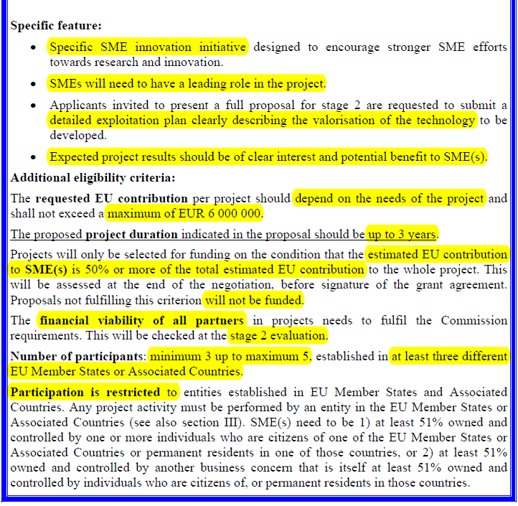
Eligibility criteria and requirements

Slide 28
Developing the idea
Submission
Identify the call & EPSS registration
Elegibility and requirement
Final validation
Developing the idea
Idea
Proposal
Part A
Partners
Budget definition
Proposal
Part B
Work plan definition

Slide 29
Developing the project idea
Developing the project idea
  Draft of the work plan
  Definition of the project total duration
  Draft of the tasks of the project, phase by phase
  Definition of the partners’ profiles to be involved (R&D centres, SMES, specific skills required, etc.)

Slide 30
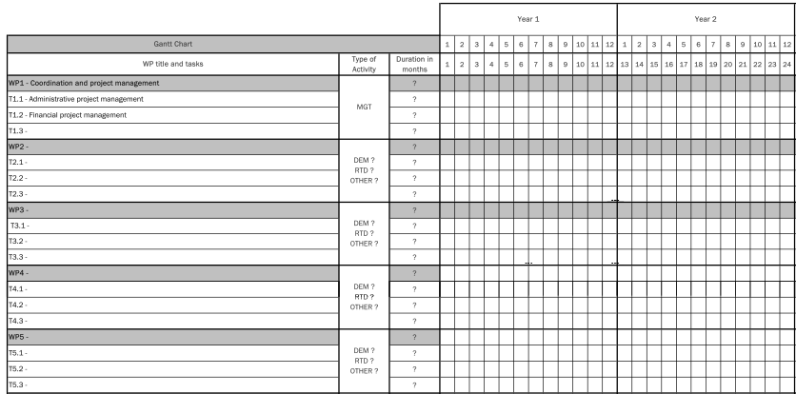
Work plan definition, activities &tasks
Gantt chart:

Slide 31
Partners
Submission
Identify the call & EPSS registration
Elegibility and requirement
Final validation
Developping the idea
Idea
Proposal
Part A
Partners
Budget definition
Proposal
Part B
Work plan definition

Slide 32
Partners
Partners eligibility check
Which countries:
  EU member states
  Associated countries
  International Cooperation Participating Countries (ICPC)
  Third countries
What type:
  Public entities without profit making
  R&D organizations (non-profit organizations)
  SMEs
  Other entities legally constituted

Slide 33
Partners
2. Contact with the partners
  Via personal contacts
  Via the Cordis tool (http://cordis.europa.eu/partners/web/guest/home)
  Via the National Contact Points (for ex. of the country you want to involve)
  Directly to the entities you want to involve
  3. Finalizing the partnership
  4. Filling in the administrative data via the EPSS

Slide 34
Work plan definition
Submission
Identify the call & EPSS registration
Elegibility and requirement
Final validation
Developping the idea
Idea
Proposal
Part A
Partners
Budget definition
Proposal
Part B
Work plan definition

Slide 35
Work plan definition
Definition of the work plan, the activities and the tasks
  Improvement of the initial work plan according to the comments of each partners
  Definition of the time plan and duration of each activity
  Definition of the roles of each partner in each task (leadership of each activity, associated skills of each partner for the task, etc.)
  Identify the resources needed by each partner for each activity/task (staff, equipment, material, travels, training, …)

Slide 36
Proposal: Part B
Submission
Identify the call & EPSS registration
Elegibility and requirement
Final validation
Developping the idea
Idea
Proposal
Part A
Partners
Budget definition
Proposal
Part B
Work plan definition

Slide 37
Proposal: Part B
  Preparing the proposal – Form B
  Writting of the contents required in the form B template
    The project has to be in line with the programme and the topic
    Analysis of the relevant politicies related with the area
    Use the templates available via EPSS or in the Guide for Applicants (annexes)
    Respect the maximum pages authorized
    All the partners should actively participate in the writting of the proposal
      Activity leaders responsible for the work plan
      End users responsible for impact
      Etc.
    Finalizing the proposal

Slide 38
Proposal: Part B contents
    Stage 1 proposal contents:
      Scientific and/or technical quality, relevant to the topics addressed by the call (Concept and objectives, Innovative character in relation to the state-of-the-art, Outline work plan)
      Impact (Expected impacts listed in the work programme)
    Stage 2 full proposal contents:
      Scientific and/or technical quality, relevant to the topics addressed by the call (Concept and objectives, Innovative character in relation to the state-of-the-art, S/T methodology and associated work plan)
      Implementation (Management structure and procedures, Individual participants, Consortium as a whole, Resources to be committed)
      Impact (Expected impacts listed in the work programme, Dissemination and/or exploitation of project results, and management of intellectual Property)
      Ethics Issues
      Consideration of gender aspects

Slide 39
Budget definition
Submission
Identify the call & EPSS registration
Elegibility and requirement
Final validation
Developping the idea
Idea
Proposal
Part A
Partners
Budget definition
Proposal
Part B
Work plan definition

Slide 40

Budget definition
  Preparing the budget (advice: prepare a detailed excel table)
  Definition of the resources needed by each partner for each activity/task (staff, equipment, material, travels, training, …)
  Definition of the costs categories according the activities
  Review/harmonize the budget according to programme/topic specifications (if applicable)
  Validation of the final budget by all the partners
      Supporting EC document: Guide to Financial Issues
      (ftp://ftp.cordis.europa.eu/pub/fp7/docs/financialguide_en.pdf)

Slide 41
Budget definition: costs categories
Activities/ Costs categories | Description | Eligible costs
Research and Technology (RTD) | Creation of new knowledge, technologies and products, incl. Scientific coordination | Direct costs: Staff Travels Equipment Consumables Subcontracting Financial certifications Indirect costs
Demonstration (DEMO) | Viability of new technologies (products tests, prototypes)
Training and Management (MGT) | Project management (legal matters within the consortium, meetings for the project management, etc.) Trainers salaries
Coordination and support (COORD/SUPP) | Coordination, networking and other ponctual activities
Other activities (OTHER) | Dissemination activities, networking, IP, studies, etc.

Slide 42
Budget definition: EC co-financing rate
 | RTD | DEMO | MGT | Other
Public entities | 75% | 50% | 100% | 100%
Secundary schools and Higher education entities
R&D organizations (non profit organizations)
SMEs
Other entities | 50%

Slide 43
Budget definition: EC co-financing rate
 | RTD | DEMO | MGT | Other
Collaborative Projects (CP) | 50% 75% | 50% | 100% | 100%
Network of Excellence (NoE) |  | -
Coordination Action (CA) | - | -
Specific Support Action (SA) | - | -

Slide 44
Budget definition: Indirect costs
Entity with an analytical accounting system:
YES
NO
Costs directly related with the direct costs of the project
Real indirect costs method
or
Simplified method
“Standard flat rate”: 20% of the total direct costs (except subcontracting)
Non-profit public entities, Higher education entities and secondary schools, R&D institutes, SMEs
“Special flat rate”: 60% of the total direct costs (except subcontracting)

Slide 45
Budget definition: Indirect costs
Entity with na analytical accounting system:
Simplified method?
YES
NO
For CSA projects:
EC contribution: Up to 7% of the total direct costs (except subcontracting)
Costs directly related with the direct costs of the project
Real indirect costs method
or
Simplified method
“Standard flat rate”: 20% of the total direct costs (except subcontracting)
Non-profit public entities, Higher education entities and secondary schools, R&D institutes, SMEs
“Special flat rate”: 60% of the total direct costs (except subcontracting)

Slide 46
Budget definition

Slide 47
Budget definition
  For ICPC: possible to choose a lump sum way to get funding
  Calculated according to various criteria:
  The “Economy of the country”: this criterion is defined by the OEDC
  The amount defined by the EC for each “Economy of the country”
  The total number of person-year for the project for the ICPC participant
  Maximum EC contribution rate according to:
    the funding scheme of the project
    The type of the partner
    Lump sum amount =
    Economy of the country x Person-year total x EC contribution rate

Slide 48
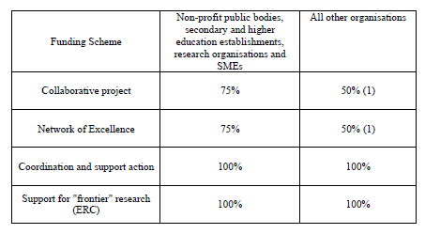
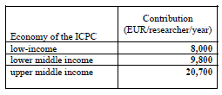

Budget definition
  For ICPC: calculation of the lump sum - Example
  “Economy of the country”
  EC contribution:
  Maximum EC contribution rate:

Slide 49

Budget definition
  Practical example for lump sum calculation: ICPC: Mexico
  Economy of Mexico: upper middle income
  Total of person-year for the project
  Funding scheme: collaborative project
  Type of partner: University
  20.700€/researcher/year
  20 person/year
  75% EC contribution rate
    Lump sum amount =
    20,700 x 20 x 75% = 310,500€

Slide 50
Proposal: Part A
Submission
Identify the call & EPSS registration
Elegibility and requirement
Final validation
Developping the idea
Idea
Proposal
Part A
Partners
Budget definition
Proposal
Part B
Work plan definition

Slide 51
Proposal: Part A
  Elaboration of the proposal – Part A – Via EPSS
  a) Filling in administrative information of each partner
  (Forms A1, A2.1., A2.2)
  b) Filling in of the amounts agreed in the project budget for each partner
  (Forms A3.1)
  c) Automatic filling in of the total budget for the project
  (Form A3.2)

Slide 52
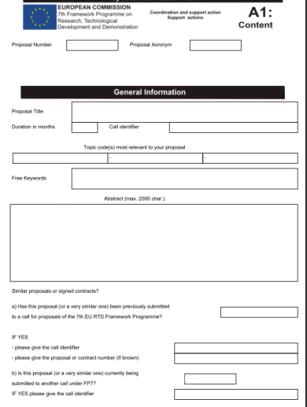
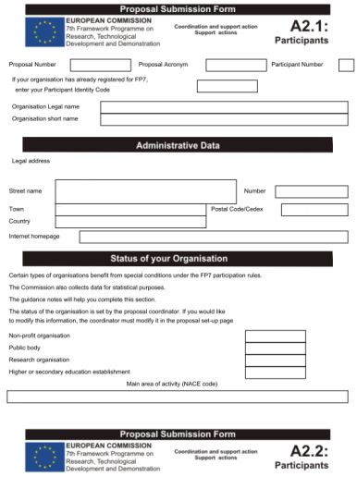
Proposal: Part A
COORDINATOR
+
PARTNERS
COORDINATOR

Slide 53
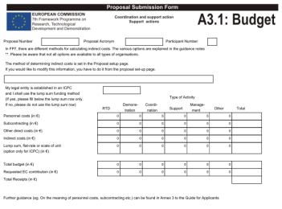
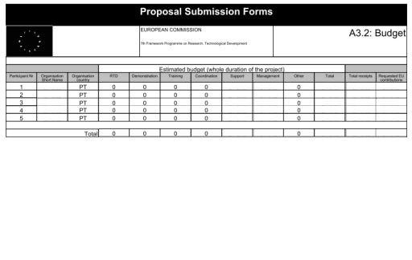
Proposal: Part A
COORDINATOR
+
PARTNERS

Slide 54
Final validation
Submission
Identify the call & EPSS registration
Elegibility and requirement
Final validation
Developping the idea
Idea
Proposal
Part A
Partners
Budget definition
Proposal
Part B
Work plan definition

Slide 55
Final validation
  Final validation of the proposal by the consortium
  Part A: Administrative forms filled in by all the partners
  Part B: Technical contents finalized (pdf format)
  Final check via EPSS “check validation” tool (check errors)
  SUBMISSION: ON-LINE & BY THE COORDINATOR!
  Proposal submitted: EPSS electronic notification by e-mail => Reference number

Slide 56
Tips…
Submission
Identify the call & EPSS registration
Elegibility and requirement
Final validation
Developping the idea
Tips to increase your success rate…
Idea
Proposal
Part A
Partners
Budget definition
Proposal
Part B
Work plan definition

Slide 57

Tips
  First participate as a partner
  Involve experienced coordinators
  Establish a strategic consortium
  Work on the idea before the publishing of the call
  Answer exactly to the description of the topic, the expected results, the impact and be in line with the European orientations
  Define an innovative approach
  Get experience as EVALUATOR of FP7 proposal

Slide 58
Contacts
UPIN - University of Porto Innovation
Aude Gabrielsen
agabrielsen@reit.up.pt
Sónia Pereira
soniapereira@reit.up.pt
Tel: +351 220408077
http://upin.up.pt

